Slide 1

American International University- Bangladesh EEE 2210 : Analog Electronics Lab
PROJECT TITLE
CLASS-AB AUDIO AMPLIFIER
COURSE TEACHER: DR. MD. KABIRUZZAMAN
SECTION: C
GROUP: 05

Slide 2

ABOUT :
.
Nourin Akter Atul
ID : 23-55750-3

Slide 3
AGENDA
Introduction
Objective
Main Components
Class AB vs. Other Classes
Working Principles

Slide 4
AGENDA
Performance
Results
Challenges Faced
Future Scope
Conclusion

Slide 5
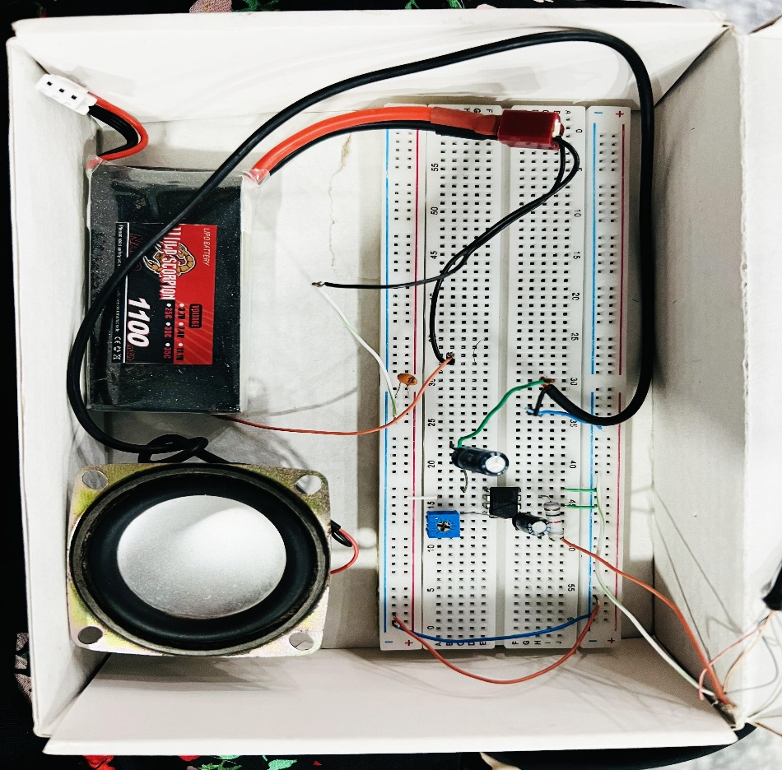
OBJECTIVES
Design and analyze a basic Class AB audio amplifier using the LM386 IC
Amplify low-power audio signals to drive a speaker effectively
Understand the function of each component within the amplifier circuit
Observe how capacitors affect signal coupling, filtering, and circuit stability
Explore real-world applications of the LM386 in audio amplification
Develop hands-on skills in simulation, circuit construction, and testing

Slide 6
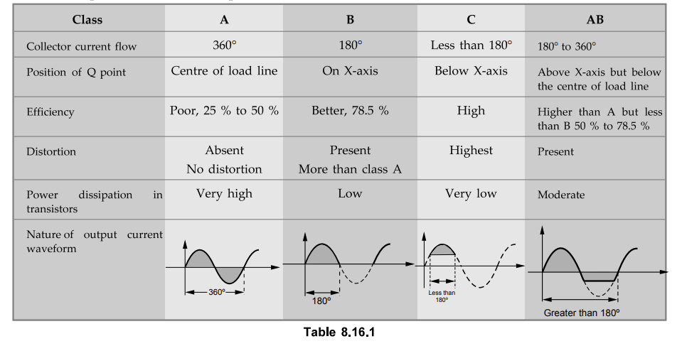
Class AB vs. Other Classes

Slide 7
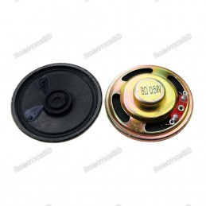
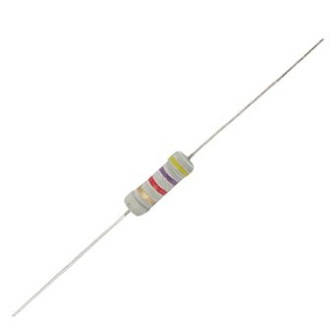
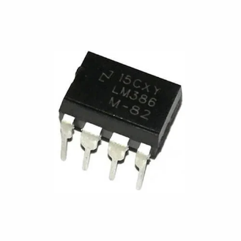
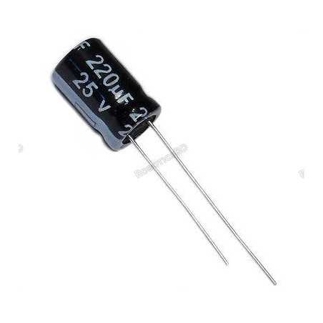
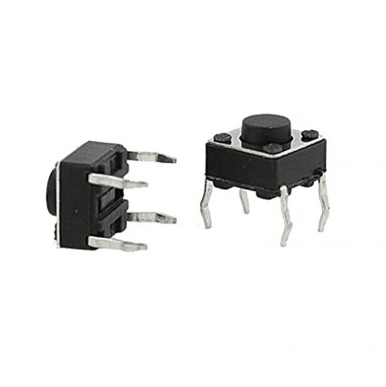
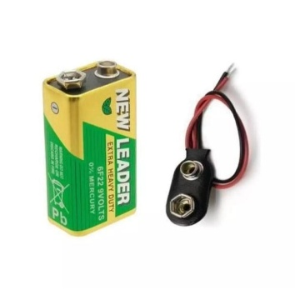
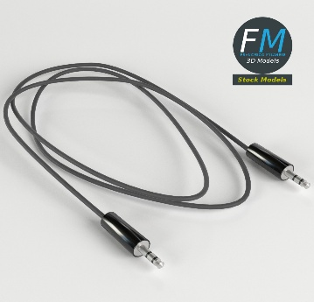
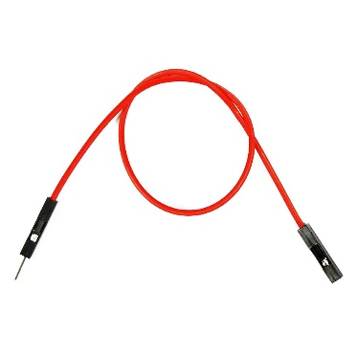
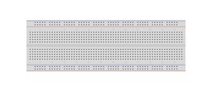
Components
LM386 Op- Amp
Capacitor 220uf,10uf,0.1uf
10k ohm resistor
Speaker
9V Battery
3mm Jack
Jumper wire
Breadboard

Slide 8

Project Setup

Slide 9
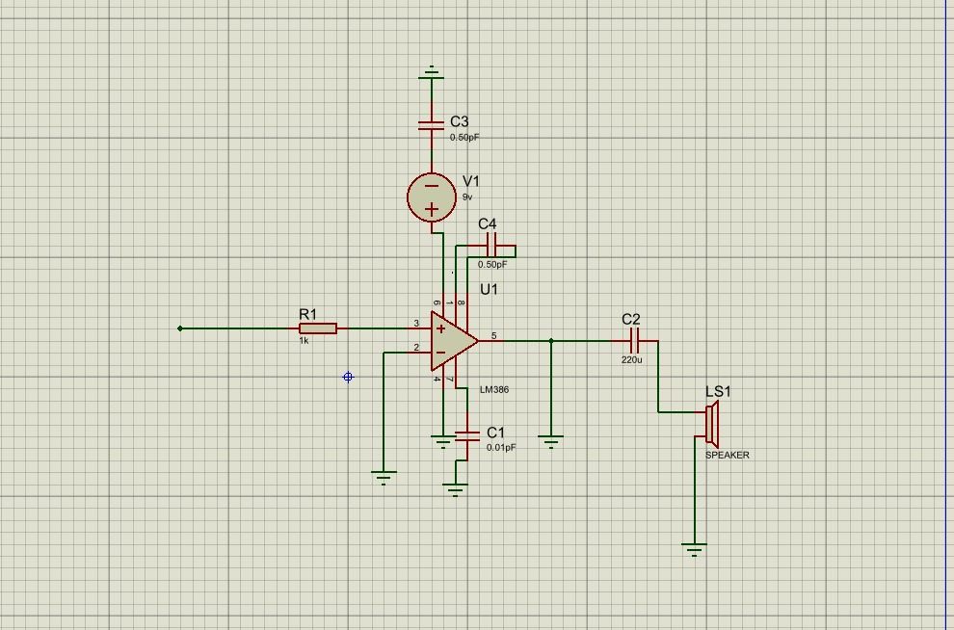
Working Method
Input Signal (Audio In)
The audio signal enters through the non-inverting input (pin 3) of the LM386.A resistor (R1) limits input current and can help filter noise
Amplification (LM386 Operation)
The LM386 amplifies the small input signal with a default gain of 20.The amplified output is taken from pin 5 for further use
Output Coupling (C2)
Capacitor C2 blocks DC and passes only the AC (audio) signal.It protects the speaker from potential DC bias damage

Slide 10
Working Method
Speaker (LS1)
Converts the amplified AC signal into sound waves.Receives a clean audio signal via the output capacitor
Power Supply Filtering (C3, C4)
C3 and C4 reduce noise and voltage spikes from the power supply.Help ensure stable and clean operation of the amplifier
Bypass Capacitor (C1)
C1 is connected to the bypass pin (pin 7) of the LM386.Improves power supply rejection and minimizes background hum

Slide 11
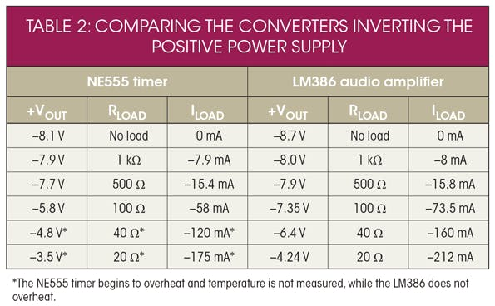
Performance Results – LM386 Amplifier
TABLE: COMPARING THE CONVERTERS INVERTING THE POSITIVE POWER SUPPLY
Stable Operation at 9V
Consistent Gain (~20x)
Efficient & Low Power Consumption
Minimal Distortion

Slide 12
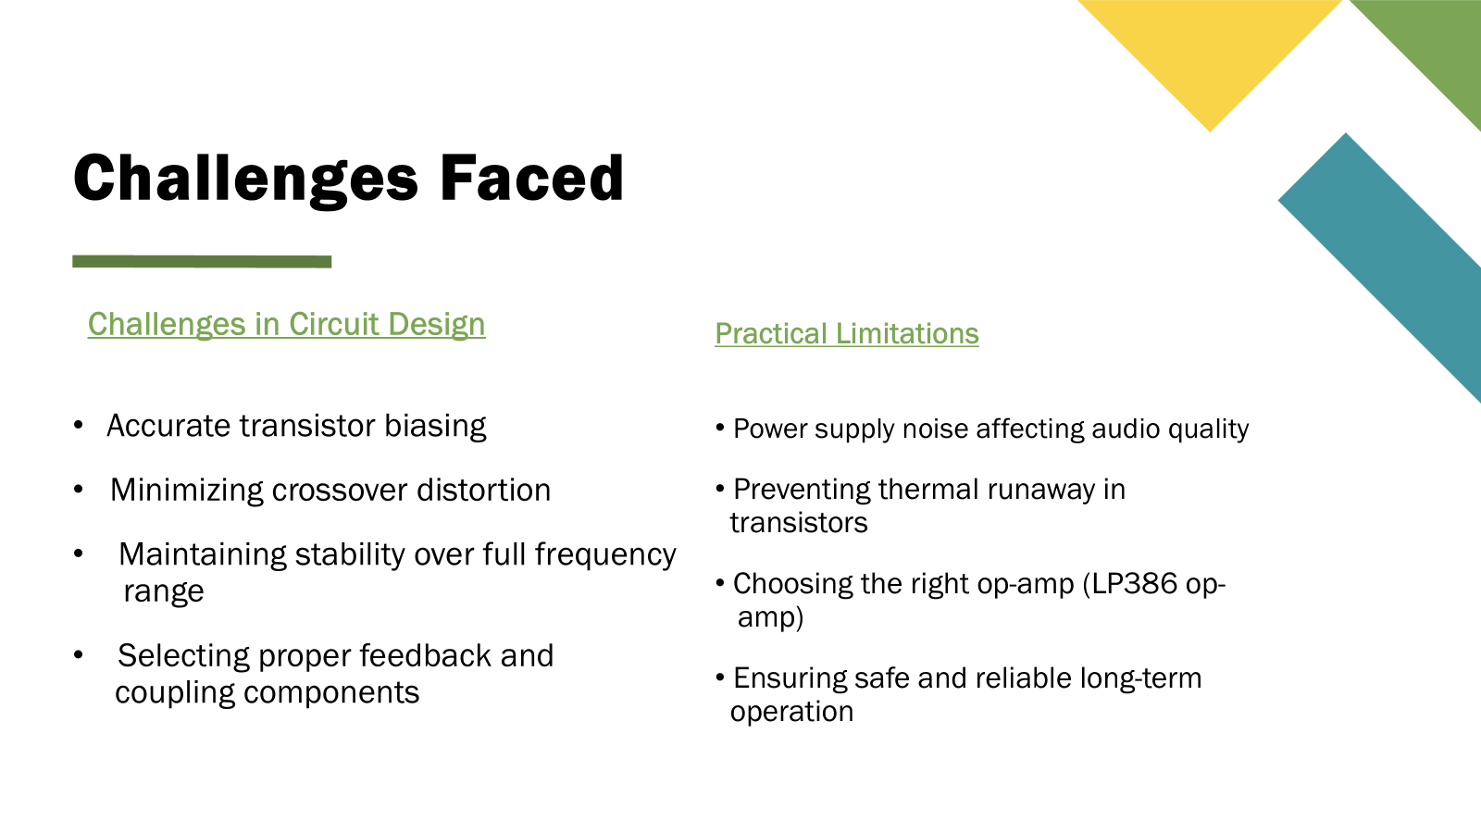
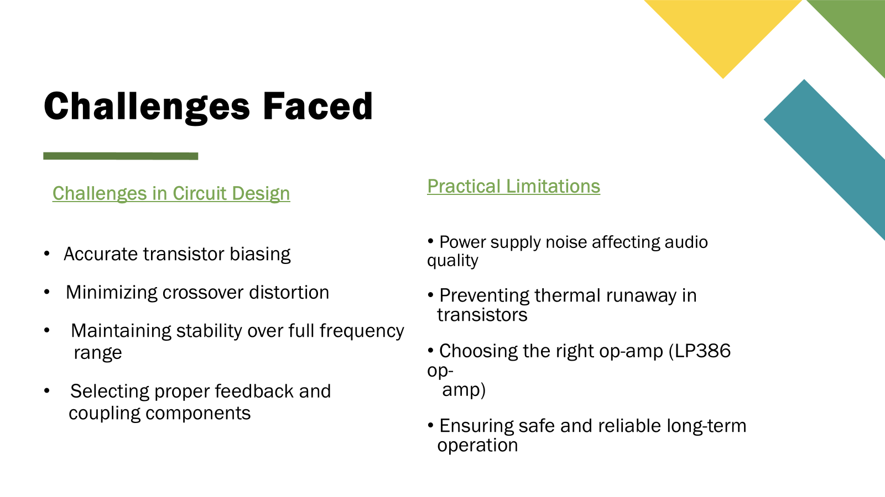
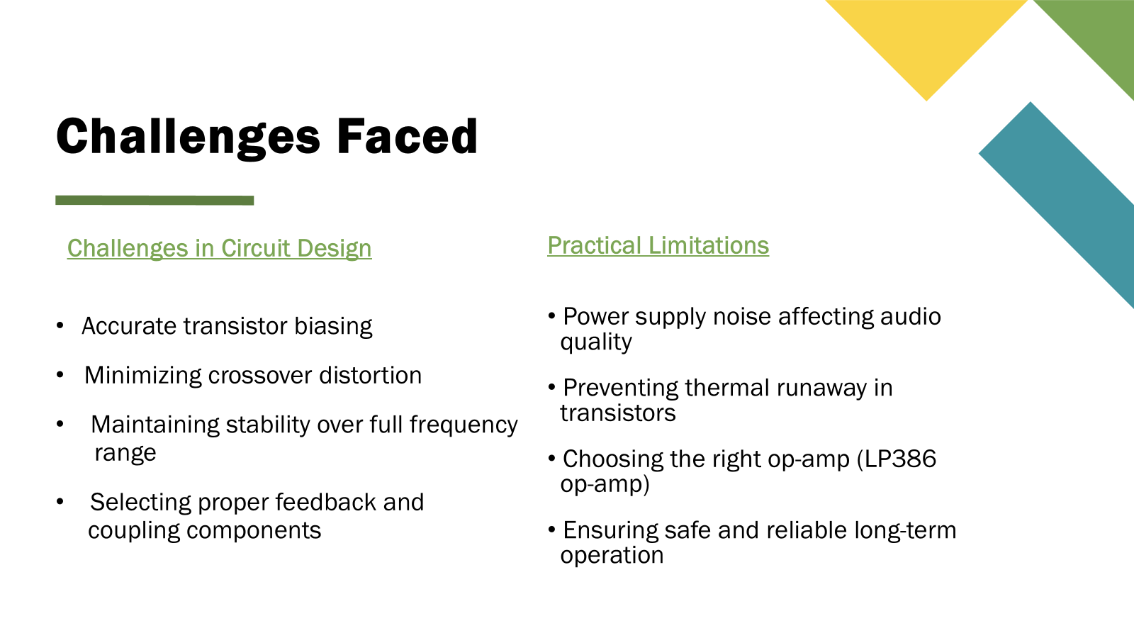
Discussion
Performance Analysis
Advantages
Challenges
Future Improvements
Real-World Applications

Slide 13
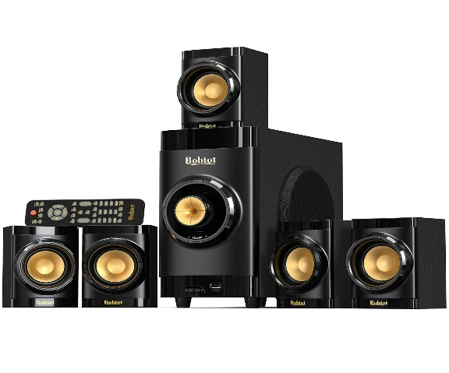
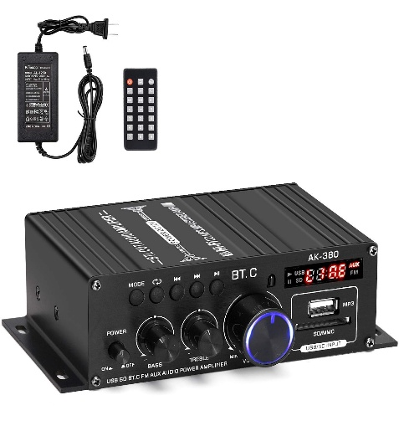
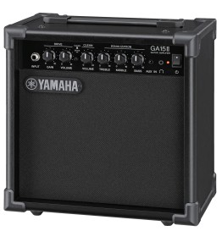
APPLICATIONS
Offer a balance of sound quality and power efficiency
Deliver clear, low-distortion sound
Ideal for driving bookshelf and floor-standing speakers
Home Audio Systems:
Car Audio Amplifiers:
Used in car audio systems to power speakers
Compact, cost-effective, and reliable
Provide good sound quality for in-vehicle use
Musical Instrument Amplifiers:
Maintains harmonic accuracy and dynamic response
Used in electric guitar and keyboard amplifiers
Preferred by musicians at moderate to high volumes

Slide 14
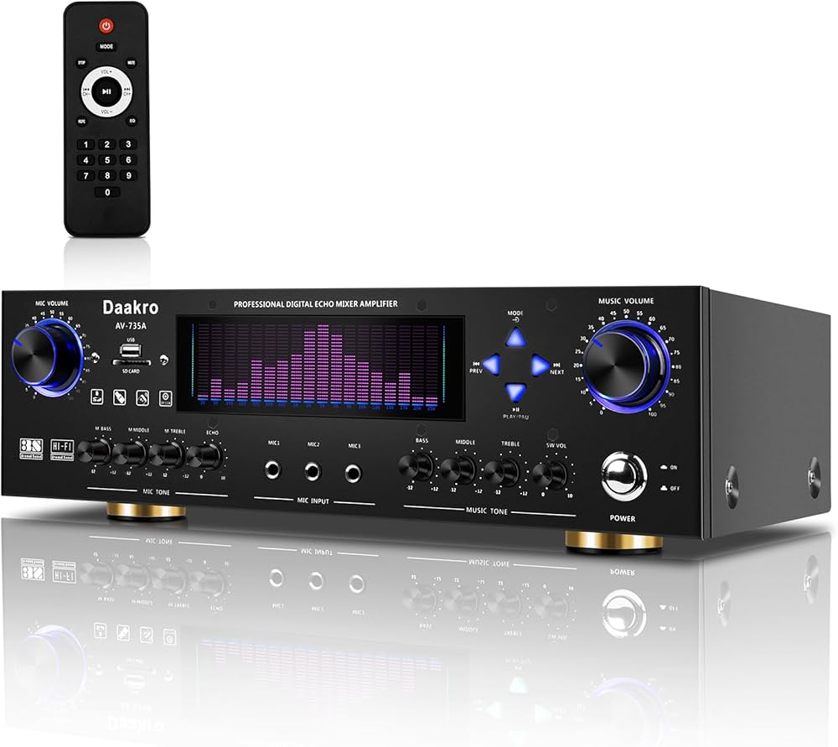
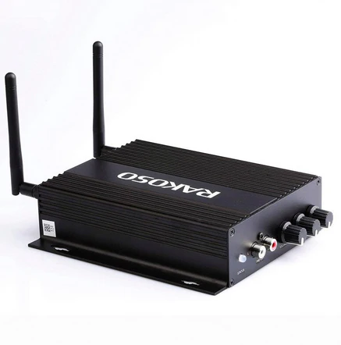
Digital Control Systems: Use of microcontrollers for automated bias control, thermal protection, and real-time monitoring
Future Scopes
Improved Power Efficiency:
Better biasing or hybrid designs (Class-G/H) to reduce heat and energy loss
Wireless Audio Integration:
Add Bluetooth or Wi-Fi for use in wireless speakers and smart home audio systems.
Compact Design for Portable Use:
Use surface-mount components and compact PCB design for portable speakers and integrated systems

Slide 15
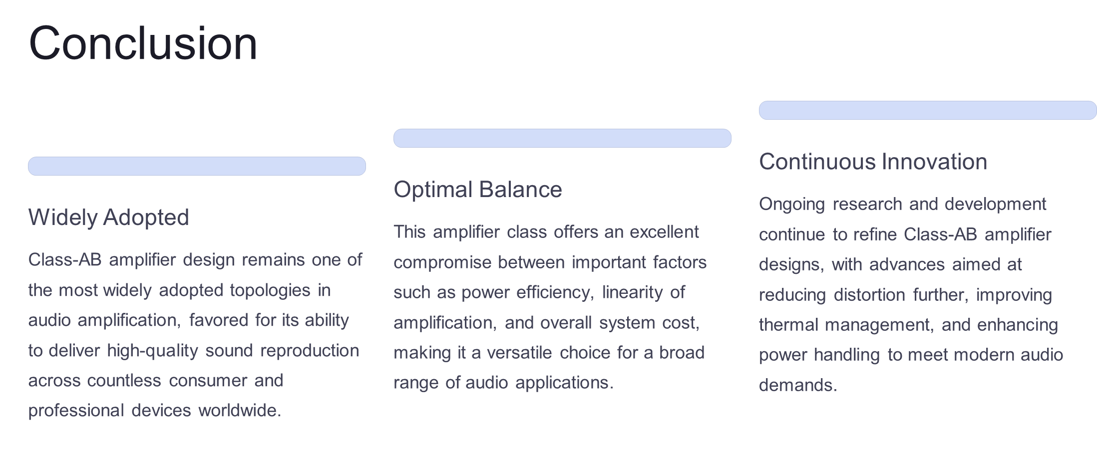

Slide 16
Thank you

Slide 17
Q & A
?

